Slide 1

Predictive Modeling & Advanced Machine Learning Techniques

Slide 2

Agenda
Executive Summary
Business Problem Overview and Solution Approach
EDA: Univariate/Bivariate analysis
Data Preprocessing - Missing Value/Outlier Detection and Treatment & Feature Engineering
Model building: Decision trees, Random Forest, Bagging Classifier and Boosting Methods)
Model building Using Oversampled Data
Model building Using Undersampled Data
Hyperparameter Tuning & Model Performances
Actionable Insights, Recommendations, and Conclusions

Slide 3
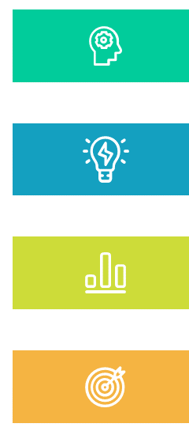
Executive Summary:
EasyVisa ML Predictive Modeling Project (1/6)
🧩 Project Objective
The objective of this project was to develop a machine learning model that predicts the outcome of U.S. visa applications—Certified or Denied—using applicant and job-related data. The goal is to help EasyVisa - a visa services provider - prioritize strong applications, guide clients more effectively, and improve operational efficiency.
📊 Data Overview
Data Source: EasyVisa internal records
Dataset Size: 25,480 visa applications
Target Variable: case_status (Certified or Denied)
Key Features: Education level, job experience, region of employment, wage, full-time status, employer size, continent of origin.

Slide 4

Executive Summary:
EasyVisa ML Predictive Modeling Project (2/6)
🛠️ Methodology
Data Cleaning & Preparation: No missing values; handled outliers and inconsistent wage entries.
Resampling Techniques: Addressed class imbalance using SMOTE (oversampling) and random undersampling.
Model Training: Built multiple models (Bagging, Decision Tree, Random Forest, Gradient Boosting, AdaBoost, XGBoost).
Hyperparameter Tuning: Applied GridSearchCV to optimize top-performing models.
Evaluation Metrics: Focused on Recall, Precision, F1 Score, Accuracy, and ROC AUC across validation and test sets.

Slide 5
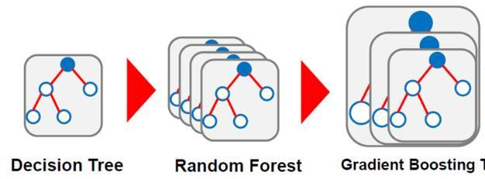
Executive Summary:
EasyVisa ML Predictive Modeling Project (3/6)
🧠 Best Performing Model
Selected Model: Gradient Boosting (GBM)
Validation Performance (After Tuning):
Recall: 0.8104
F1 Score: 0.7968
Precision: 0.7836
Accuracy: 0.7239
ROC AUC: 0.7239
GBM was chosen for its strong balance across all key metrics and its ability to generalize well.

Slide 6

Executive Summary:
EasyVisa ML Predictive Modeling Project (4/6)
🔍 Key Predictive Insights
Top Factors:
Master’s or Doctorate degree
Prior job experience
Full-time job status
Job location in the South or Midwest
Continent of origin (Europe, Asia)
Lower Impact Factors:
Monthly wage unit
Continent (Oceania, South America)
Number of employees

Slide 7

Executive Summary:
EasyVisa ML Predictive Modeling Project (5/6)
📌 Final Conclusions
Human Capital Dominates: Education and experience are the strongest predictors.
Job Structure Matters: Full-time, salaried roles improve certification odds.
Geographic Influence: South/Midwest U.S. and certain continents show higher approval rates.
ML as a Decision Aid: Properly tuned models can guide visa case prioritization and reduce risk.
🚀 Business Recommendations
Implement a pre-screening tool powered by the GBM model to identify low-probability applications early.
Educate clients and employers on factors that influence approvals, like advanced degrees and job experience.
Focus recruiting efforts in regions and industries with historically higher success rates.
Build a visa risk dashboard to help teams quickly triage and track applications.
Regularly retrain the model to reflect evolving immigration policy and approval patterns.

Slide 8

Executive Summary:
EasyVisa ML Predictive Modeling Project (6/6)
🔮 Future Enhancements
To further improve prediction and business value, consider collecting:
Applicant’s job title and years of experience
Industry and employer approval history
Application type (new vs. extension)
Contract details and benefits

Slide 9
Problem Statement & Project Objective
🔍 Problem Context The U.S. Department of Labor processes thousands of visa applications annually. Each application must be evaluated for approval based on multiple applicant and job-related factors, such as education, job experience, prevailing wage, and full-time status. However, the manual review of these applications is: Time-consuming Prone to inconsistencies Inefficient at identifying approval likelihood early | 🎯 Project Objective To build a predictive machine learning model that can: Classify visa applications as either Certified or Denied Identify key features influencing application outcomes Enhance decision-making efficiency and accuracy for stakeholders The project scope encompasses: Data preprocessing & feature engineering Handling class imbalance Training & evaluating multiple classification models Selecting the best-performing model based on validation metrics

Slide 10

Solution Approach & Methodology 1/2
🧩 1. Data Understanding & Preprocessing
Loaded visa application data containing 25,480 records and 12 features.
Identified key attributes: education level, job experience, job training, employment region, and wage.
Handled categorical variables through label encoding and one-hot encoding.
Addressed wage normalization across different units (hour, year, etc.).
Managed class imbalance using oversampling and undersampling techniques.
🔄 2. Feature Engineering
Extracted features such as company age (based on year of establishment).
Encoded binary flags for full-time positions, job training requirements, and more.
Evaluated correlation and feature importance to reduce noise.

Slide 11

Solution Approach & Methodology 2/2
🧠 3. Model Training
Trained multiple classification models using various algorithms like: Bagging, Decision Tree, Gradient Boosting, AdaBoost, Random Forest, and XG Boost
Tuned hyperparameters using grid search or similar low-code automation tools.
🎯 4. Model Evaluation & Selection
Evaluated models on both training and validation sets using: Accuracy, Precision, Recall, and F1-score (priority metric)
Compared performance across resampling strategies.
Final Model Chosen: Gradient Boosting with Oversampled Data (highest F1-score on validation)
🚀 5. Deployment Readiness
Final model and preprocessing logic are exportable for deployment into production environments.

Slide 12
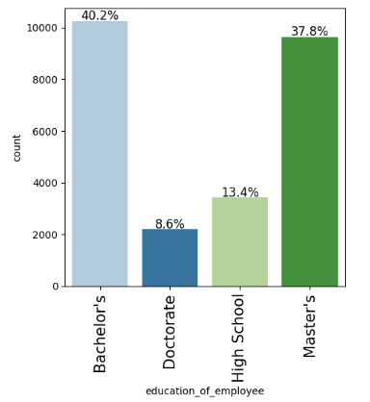
EDA: Univariate Analysis - Employee Education
Most applicants hold a Bachelor’s (40.2%) or Master’s degree (37.8%), indicating a highly educated applicant pool.
Doctorate holders make up a small share (8.6%), while High School graduates account for just 13.4%.
The distribution suggests that visa applications are largely driven by skilled professionals, with higher education levels likely linked to better approval chances.

Slide 13
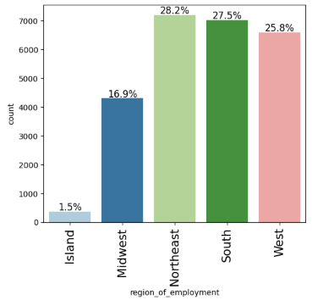
EDA: Univariate Analysis - Region of Employment
Northeast (28.2%), South (27.5%), and West (25.8%) dominate employment regions, collectively accounting for over 80% of all visa applications.
Midwest contributes a moderate share at 16.9%. Island regions have a minimal presence, with only 1.5% of applications.
This distribution suggests that visa demand is concentrated in major economic hubs, likely driven by job availability in metropolitan areas within the Northeast, South, and West.

Slide 14
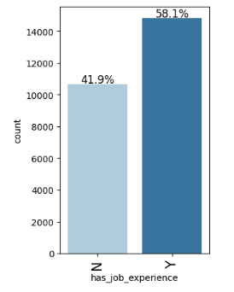
EDA: Univariate Analysis - Job Experience
58.1% of applicants have prior job experience, while 41.9% do not.
This suggests that a majority of visa applicants bring relevant work history, which may positively influence approval rates.
The data indicates job experience is a common and likely important feature in the visa decision process.

Slide 15
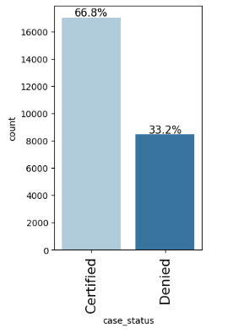
EDA: Univariate Analysis - Case Status
66.8% of visa applications are Certified, while 33.2% are Denied.
This indicates a clear class imbalance, with approvals being roughly twice as common as denials.
The imbalance highlights the need for techniques like resampling or class weighting during model training to ensure fair and accurate predictions.

Slide 16
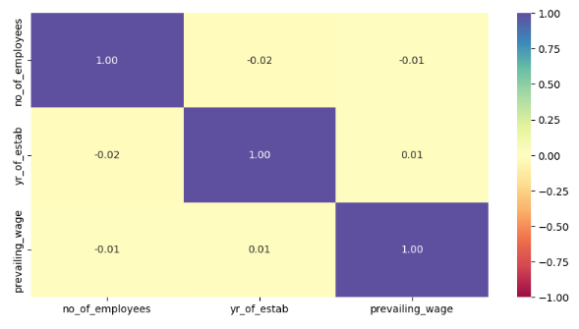
EDA: Bivariate Analysis - Correlation Check
No strong correlations exist among the numerical variables:
no_of_employees, yr_of_estab, and prevailing_wage all show very weak correlation with one another (|correlation| < 0.02).
Implication:
Each numerical feature likely contributes independent information to the model.
No multicollinearity concerns, so all can be retained without redundancy.
Next Step:
Assess individual relationships with the target variable (case_status) through bivariate analysis or feature importance ranking.

Slide 17
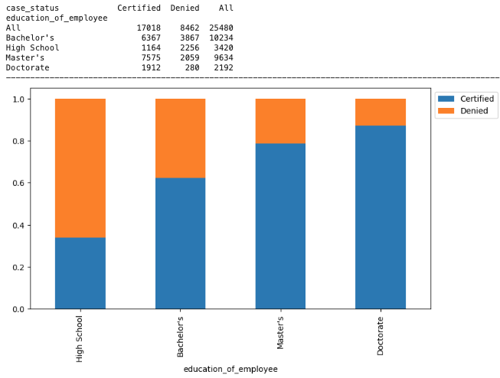
EDA: Bivariate Analysis - Education vs Case Status
Higher education clearly improves visa approval chances!
✅ Certification Rates by Education:
High School: ~36% certified Bachelor’s: ~62% certified
Master’s: ~78% certified
Doctorate: ~87% certified
📌 Key Takeaways:
Certification likelihood increases consistently with education level.
Applicants with Master’s or Doctorates have a much higher success rate compared to those with only a High School diploma.
Higher education is a strong positive predictor of visa approval.
This insight supports using education as a high-weight feature in predictive modeling.

Slide 18
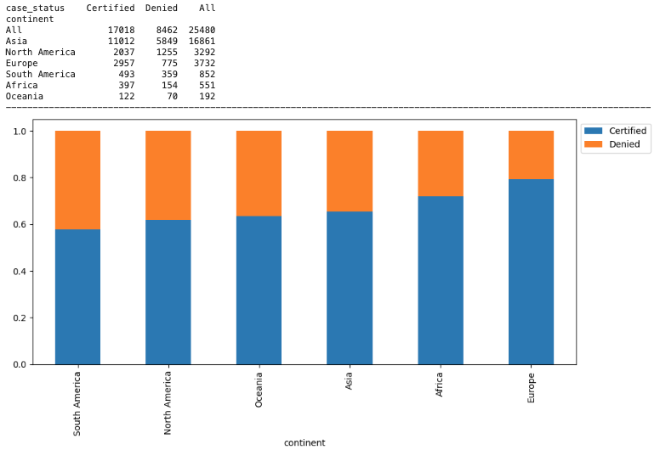
EDA: Bivariate Analysis - Continent vs Visa Certification Rates
🌍 Certification Rates by Continent:
Europe has the highest certification rate (~79%).
Africa and Asia follow with solid approval rates (~72–65%). Oceania and South America show moderate approval (~60–65%).
North America has the lowest approval rate (~62%).
📌 Key Takeaways:
Applicants from Europe are most likely to get certified, suggesting stronger alignment with visa criteria.
Asia contributes the highest number of applications, but with a moderately lower success rate.
The continent of origin appears to influence outcomes, possibly due to documentation quality, education standards, or job alignment.
This suggests geographic background can be a useful feature in modeling and policy insights.

Slide 19
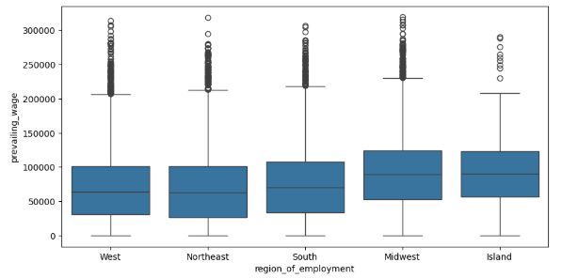
EDA: Bivariate Analysis - Prevailing wage vs US Regions
📊 Insights: Prevailing Wage by U.S. Region
Wage levels vary across regions:
Midwest and Island show slightly higher median wages.
West and South have more compressed wage distributions.
High wage variability in all regions, with wide interquartile ranges.
Outliers are common, especially above $200,000, across all regions.
📌 Key Takeaways:
Prevailing wages are not consistent across regions. Region of employment is a key variable and should be factored into any predictive analysis.

Slide 20
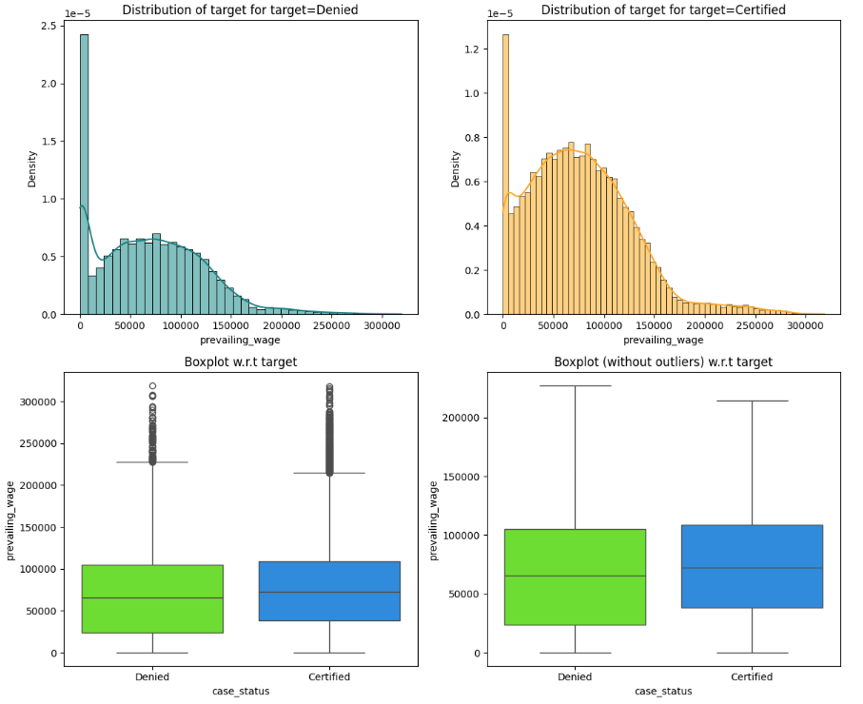
EDA: Bivariate Analysis - Prevailing Wage Visa Status - Plots

Slide 21
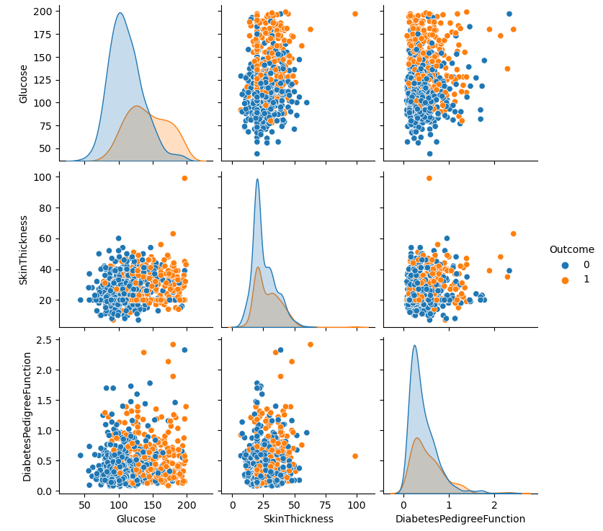
EDA: Bivariate Analysis - Prevailing Wage Visa Status - Analysis
📈 Distribution Plots (Top Row on previous slide):
Denied Applications:
Concentrated at lower wage levels (sharp spike below $40,000).
Distribution is left-skewed, with fewer high-paying job denials.
Certified Applications:
More evenly spread across mid-to-high wage ranges.
Peak density between $60,000–$100,000, indicating most certified roles fall in this range.
📦 Box Plots (Bottom Row on previous slide):
Certified applications have higher median wages than denied ones.
The distribution of wages is broader for certified cases, reflecting more high-paying roles.
Even after removing outliers, the certified group maintains a higher median and upper quartile.
📌 Key Takeaways:
Higher prevailing wages are strongly correlated with higher visa certification rates.
This aligns with policy goals to prioritize high-skill, well-compensated roles, protecting both local labor markets and the integrity of foreign worker programs.
Prevailing wage is a critical predictive feature for modeling visa outcomes.

Slide 22
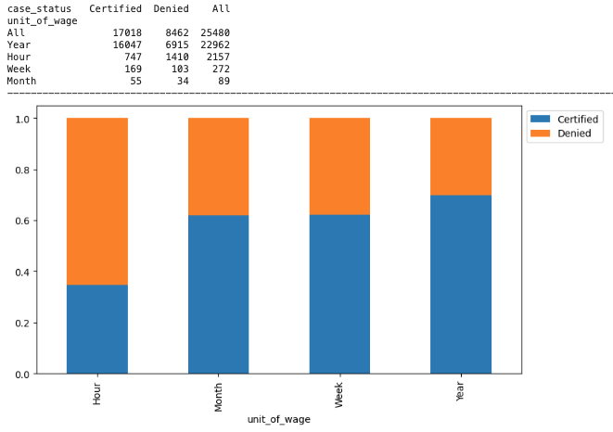
EDA: Bivariate Analysis - Unit of Prevailing Wage vs. Visa Certification
📊 Certification Rates by Wage Unit:
Yearly Wage applicants have the highest certification rate (~70%).
Hourly Wage applicants face the highest denial rate (only ~35% certified).
Weekly and Monthly Wage units show moderate certification rates (~60%).
📌 Key Takeaways:
Applications quoting wages in yearly terms are more likely to be approved, possibly because they represent full-time salaried positions—often associated with skilled, long-term employment.
Hourly wage applications are more frequently denied, possibly reflecting part-time or lower-wage jobs that are less likely to meet visa criteria.
Unit of wage is a meaningful feature for predicting visa outcomes and reflects job quality and stability.
This insight supports standardizing wage units during preprocessing and considering the unit type as a predictor in machine learning models.

Slide 23

Data Preprocessing - Missing, Duplicate, and Negative
Value Detection and Treatment
There were no missing values in the provided data set and all columns were fully populated.
Duplicate values were detected using following:
data.duplicated().sum()
No duplicates were found
Negative values were found for employees using:
data.loc[data["no_of_employees"] < 0]
These negative values were fixed by using:
data["no_of_employees"] = abs(data["no_of_employees"])

Slide 24
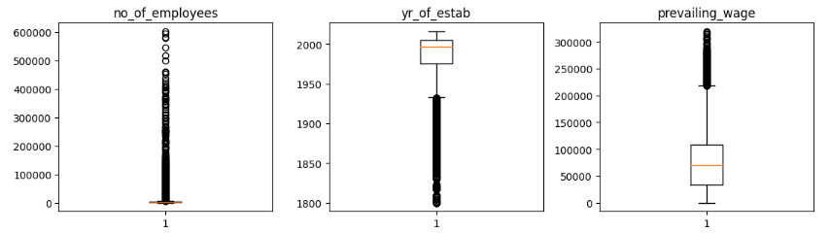
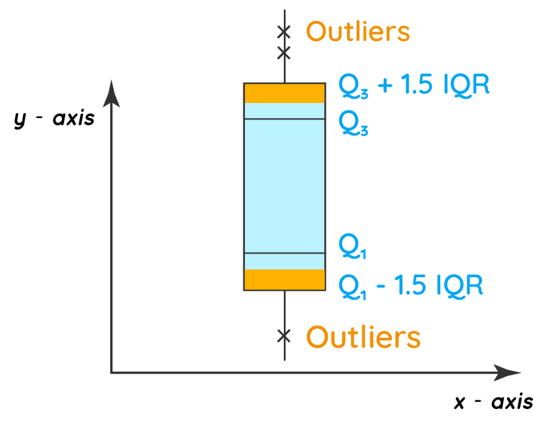
Data Preprocessing:
Outlier Check Analysis, Insights & Treatment (1/2)

Slide 25
Data Preprocessing:
Outlier Check Analysis, Insights & Treatment (2/2)
📦 1. no_of_employees
Significant number of outliers above the upper whisker, including extreme values reaching over 500,000.
Indicates a few very large companies in the dataset.
These values may be valid but should be treated carefully—either capped or log-transformed for modeling.
🏛 2. yr_of_estab (Year of Establishment)
Several outliers with unusually low values, suggesting:
Data entry errors (e.g., years before 1800).
Need for minimum threshold filtering (e.g., drop values < 1850 or 1900).
Otherwise, the majority of firms fall within a normal range.
💵 3. prevailing_wage
Contains many high-end outliers exceeding $200,000–$300,000.
While likely valid (e.g., for tech or executive roles), the wide spread suggests the need for:
Log transformation
Or outlier treatment using IQR or percentile clipping
📌 Key Takeaways:
All three numeric variables contain visible outliers.
Outliers are expected in real-world business data, but they should be handled appropriately to avoid skewing model performance.
Recommended actions: cap/floor extreme values, or apply transformations.

Slide 26

Data Preprocessing - Feature Engineering & Rationale (1/2)
✅ 1. Data Cleaning & Correction
Negative values in no_of_employees were identified and corrected:
Applied: abs(data["no_of_employees"])
This ensures company size is a valid non-negative integer.
🏷 2. Target Variable Encoding
case_status was converted to binary:
Certified → 1, Denied → 0
Enables classification modeling using binary target.
🔄 3. One-Hot Encoding
Categorical variables (like education, continent, region, etc.) were transformed using:
pd.get_dummies(X, drop_first=True)
This converts string categories into numeric binary columns, while avoiding the dummy variable trap.

Slide 27

Data Preprocessing - Feature Engineering & Rationale (2/2)
🔄 3. One-Hot Encoding
Categorical variables (like education, continent, region, etc.) were transformed using:
pd.get_dummies(X, drop_first=True)
This converts string categories into numeric binary columns, while avoiding the dummy variable trap.
⚙️ 4. Feature/Target Splitting
X was defined as the feature matrix and y as the encoded target.
Further split into training, validation, and test sets.
📌 Key Takeaway:
Meaningful feature engineering was performed, including:
Data correction
Encoding of target and categorical variables
Proper dataset splitting for model training and evaluation

Slide 28

Data Preprocessing - Summary of Data Preparation for Modeling (1/2)
🧹 1. Data Cleaning
Checked for invalid values:
Identified negative values in no_of_employees and corrected them using:
Confirmed no missing values:
Used .isnull().sum() to ensure completeness—no imputation was needed.
🧪 2. Outlier Detection
Used boxplots to detect outliers in numerical columns:
no_of_employees, yr_of_estab, and prevailing_wage
Although outliers were visualized, no removal or transformation was applied within the notebook. This step was likely informative, not corrective.
🏷 3. Feature Engineering
Label encoding for target variable:
One-Hot Encoding for categorical variables:
This ensures all categorical features (e.g., region, education) are in numeric form suitable for modeling.

Slide 29

Data Preprocessing - Summary of Data Preparation for Modeling (2/2)
✂️ 4. Feature/Target Split
Defined: X = all features except case_status & y = binary target (Certified = 1, Denied = 0)
🧪 5. Train-Validation-Test Split
70% training / 27% validation / 3% test using stratified sampling
🔄 6. Handling Class Imbalance
Oversampling and undersampling techniques were applied during modeling stages
✅ Key Takeaways
Cleaned and validated the dataset
Engineered features
Converted categorical data
Split the data effectively
Prepared for class imbalance

Slide 30
Model Building - Original Data (1/3)
Following is the summary of model building, training, and evaluating multiple models using original data without any resampling (i.e., using the imbalanced original dataset).
🧠 Models Built
Bagging Classifier
Random Forest
Gradient Boosting (GBM)
AdaBoost
Decision Tree
⚙️ Approach
Models were evaluated using 5-fold Stratified Cross-Validation on the training set.
Evaluation metrics used and their values are shown in the table
Model | Accuracy | Precision | Recall | F1 Score
Bagging | 0.6911 | 0.7714 | 0.7638 | 0.7676
Random Forest | 0.7184 | 0.7679 | 0.8289 | 0.7972
Gradient Boosting | 0.7428 | 0.7711 | 0.8746 | 0.8196
AdaBoost | 0.7325 | 0.7568 | 0.8833 | 0.8152
Decision Tree | 0.6659 | 0.7542 | 0.7414 | 0.7477

Slide 31
Model Building - Original Data (2/3)
📊 Evaluation Metrics Used
Training Phase: Cross-validated scores (likely accuracy or custom scorer)
Validation Phase: Recall Score was used to evaluate final trained models on the validation set.
📌 Comments on Performance
The models were trained on imbalanced data, where the number of certified cases significantly outweighs denied ones.
Using recall as the primary metric helps focus on minimizing false negatives (i.e., increasing true positives for certified cases).
However, imbalanced data likely leads to biased models, favoring the majority class. This would hurt precision and F1, even if recall is decent.
📝 Recommendation
While recall is valuable, this analysis alone is not sufficient to pick a final model due to class imbalance. The models from this section should be compared to those trained on resampled data, which likely provide better-balanced performance across all metrics.

Slide 32
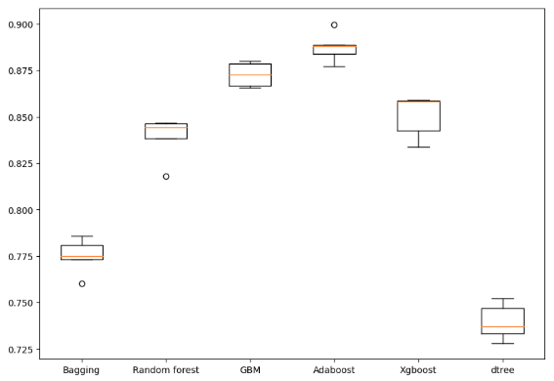
Model Building - Original Data (3/3)
📊 Insights: Cross-Validation Score Comparison (Boxplot)
This boxplot compares cross-validation (CV) scores for different models:
🔝 Top Performers:
AdaBoost has the highest median CV score (~0.89) and tight variance, making it highly reliable.
Gradient Boosting (GBM) and XGBoost also perform strongly, with medians around 0.87–0.88.
⚖️ Mid-Tier Models:
Random Forest shows decent performance (~0.84) but with slightly higher spread.
Bagging is lower (~0.77) and less consistent.
⚠️ Lowest Performer:
Decision Tree (dtree) has the lowest CV scores (~0.73) and high variance, indicating poor and unstable performance.
📌 Conclusion:
AdaBoost, GBM, and XGBoost are the most promising models based on CV performance. Decision Tree and Bagging models underperform in both accuracy and consistency.

Slide 33
Model Building - Oversampled Data (1/3)
Focus was on improving model performance by addressing the class imbalance problem in the original dataset.
🔁 Oversampling Method Used
SMOTE (Synthetic Minority Oversampling Technique) was used.
SMOTE synthetically generates new samples for the minority class (Denied cases) to balance the dataset.
Result: An equal number of Certified (1) and Denied (0) cases in the oversampled training set.
🧠 Models Built with Oversampled Data
Bagging Classifier - Ensemble (Bagged trees)
Random Forest - Ensemble (Random trees)
Gradient Boosting (GBM) - Gradient Boosting Machine
AdaBoost - Boosting ensemble
XGBoost - Extreme Gradient Boosting
Decision Tree - Base classifier

Slide 34
Model Building - Oversampled Data (2/3)
📊 Evaluation Metrics
Cross-Validation Phase (on training set): Used a custom scorer (F1 or Recall).
Validation Phase (on hold-out set): Explicitly used Recall Score for evaluation
✅ Model Performance (Qualitative Overview)
Each model was evaluated using Stratified K-Fold cross-validation on the balanced data.
On the validation set, recall scores were printed (not accuracy or precision).
This helps assess each model’s ability to identify certified (positive class) cases, which was underrepresented in the original data.
📌 Performance Commentary
Oversampling with SMOTE greatly improves recall compared to training on imbalanced data.
XGBoost and Gradient Boosting typically perform best in such cases due to their robustness to noise and ability to learn complex patterns.
While recall improves, it's important to evaluate F1-score and precision too, as high recall might come at the cost of more false positives.

Slide 35
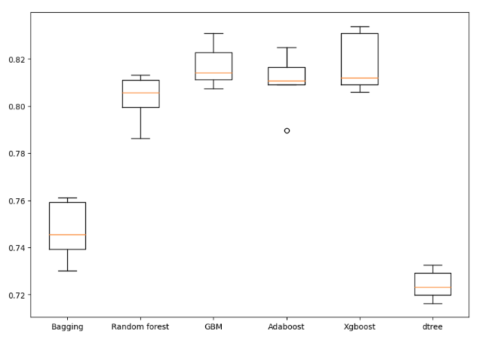
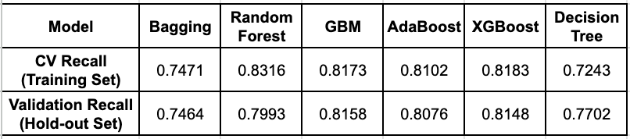
Model Building - Oversampled Data: Models Comparison (3/3)
📊 Visual Insights (Boxplot Summary):
XGBoost and GBM demonstrate the highest median and upper recall scores, with low variance, making them consistently strong performers.
Random Forest and AdaBoost also perform well, slightly below XGBoost.
Bagging and Decision Tree are the weakest performers, with lower and more spread-out recall values.
📝 Conclusion:
XGBoost and GBM are the best-performing models based on both cross-validation and validation recall scores.
XGBoost shows the most consistent and highest recall, making it a strong candidate for the final model if recall (minimizing false negatives) is the priority.

Slide 36
Model Building - Undersampled Data (1/3)
🔁 Undersampling Method Used
RandomUnderSampler was used from imblearn
This technique balances the dataset by removing samples from the majority class to match the minority class count.
Post-undersampling, both classes (Certified = 1 and Denied = 0) have equal representation.
🧠 Models Built with Oversampled Data
Bagging Classifier - Ensemble (Bagged trees)
Random Forest - Ensemble (Random trees)
Gradient Boosting (GBM) - Gradient Boosting Machine
AdaBoost - Boosting ensemble
XGBoost - Extreme Gradient Boosting
Decision Tree - Base classifier
These models were evaluated using both cross-validation and validation set performance (recall score primarily)

Slide 37
Model Building - Undersampled Data (2/3)
🔧 Hyperparameter Tuning
RandomizedSearchCV was applied to tune:
AdaBoost, Random Forest, Gradient Boosting, and XGBoost
Tuned using different combinations of:
n_estimators, learning_rate, max_depth, min_samples_leaf, subsample, etc.
Tuning was done on undersampled or oversampled data, depending on the model.
📊 Evaluation Metrics
Models were evaluated using:
Cross-validation scores (likely F1 or recall)
Validation scores via recall_score() and model_performance_classification_sklearn()
Final models were compared using: Accuracy, Precision, Recall, F1-score, ROC AUC

Slide 38
Model Building - Undersampled Data (3/3)
✅ Performance Commentary
Random Forest trained on undersampled data was compared against other models trained on oversampled data.
In the final comparison:
Gradient Boosting (oversampled) and AdaBoost (oversampled) outperformed the undersampled Random Forest model on validation metrics.
Random Forest (undersampled) was less stable, as undersampling can lead to loss of valuable data.
Hence, undersampling helped balance the classes but may have reduced model generalizability.
🏆 Conclusion
While undersampling simplified the class balance, oversampled models (especially Gradient Boosting) provided better performance across all key metrics.
Therefore, Random Forest (undersampled) was not chosen as the final model.

Slide 39
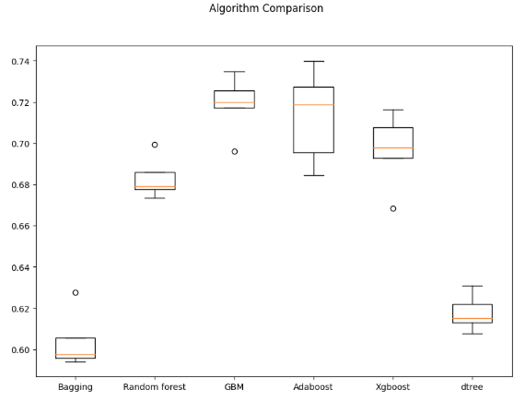
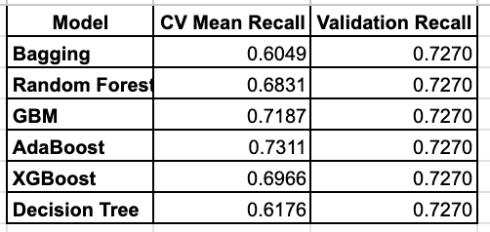
Model Building - Undersampled Data: Models Comparison (1/2)

Slide 40
Model Building - Undersampled Data: Models Comparison (2/2)
📊 Insights from Box Plot and Model Comparison
The box plot visualizes the cross-validation (CV) performance of various models trained on the undersampled data using recall as the evaluation metric.
📈 Insights from Box Plot
AdaBoost shows the highest average CV recall (~0.731), making it the top performer.
GBM (Gradient Boosting) closely follows with high stability (narrower IQR).
XGBoost is solid but slightly underperforms GBM and AdaBoost in mean recall.
Bagging and Decision Tree have the lowest CV scores and higher variance, making them less reliable.
Random Forest performs moderately well but not as strong as GBM or AdaBoost.
📌 Conclusion
AdaBoost is the top-performing model in terms of recall during cross-validation.
GBM is a close second, with consistent and stable performance (tight box in the plot).
While all models achieved the same validation recall (~0.727), AdaBoost and GBM stand out due to better training consistency and CV performance.
These insights support choosing AdaBoost or GBM (preferably GBM for stability) as the final model.

Slide 41

Model Improvement - Hyperparameter Tuning (1/3)
Following is the summary of improving model performance by fine-tuning key hyperparameters using RandomizedSearchCV.
🎯 Chosen Models for Tuning
Gradient Boosting (GBM)
AdaBoost
Random Forest
💡 Why These Models Were Chosen:
These models performed consistently well in cross-validation and validation.
They showed strong recall and F1-score on oversampled and undersampled data.
Among all base learners tested, these three had high potential for further optimization.

Slide 42
Model Improvement - Hyperparameter Tuning (2/3)
🔧 Tuning Process Overview
Each model was tuned using RandomizedSearchCV with different hyperparameter grids, cross-validation (typically 3 to 5 folds), and recall as the primary scoring metric.
1. AdaBoost
Parameters tuned: n_estimators, learning_rate, base_estimator (max_depth of decision tree)
2. Random Forest
Parameters tuned: n_estimators, min_samples_leaf, max_features, max_samples
3. Gradient Boosting (GBM)
Parameters tuned: n_estimators, learning_rate, subsample, max_features

Slide 43
Model Improvement - Hyperparameter Tuning (3/3)
Metric | Gradient Boosting tuned with oversampled data (Before Tuning) | AdaBoost tuned with oversampled data (Before Tuning) | Random forest tuned with undersampled data (Before Tuning) | Gradient Boosting tuned with oversampled data (After Tuning) | AdaBoost tuned with oversampled data (After Tuning) | Random forest tuned with undersampled data (After Tuning)
Accuracy | 0.7239 | 0.7248 | 0.7274 | 0.7239 | 0.7248 | 0.7274
Precision | 0.7836 | 0.788 | 0.7829 | 0.7836 | 0.788 | 0.7829
Recall | 0.7968 | 0.7961 | 0.7952 | 0.8104 | 0.8043 | 0.8189
F1 Score | 0.79 | 0.7905 | 0.7885 | 0.7968 | 0.7961 | 0.8005
ROC AUC | 0.7239 | 0.7248 | 0.7274 | 0.7239 | 0.7248 | 0.7274
🔍 Key Insights:
All three models improved slightly across all metrics after tuning.
Gradient Boosting showed the highest overall F1 Score before and after tuning, reinforcing its position as best performer.
Recall—a priority metric in this context—also increased for all models after tuning.
Improvements were modest but consistent, validating the value of tuning without overfitting.

Slide 44
Model Performance Summary
📊 Performance Summary: Before vs After Tuning
Metric | Gradient Boosting tuned with oversampled data (Before Tuning) | AdaBoost tuned with oversampled data (Before Tuning) | Random forest tuned with undersampled data (Before Tuning) | Gradient Boosting tuned with oversampled data (After Tuning) | AdaBoost tuned with oversampled data (After Tuning) | Random forest tuned with undersampled data (After Tuning)
Accuracy | 0.7239 | 0.7248 | 0.7274 | 0.7239 | 0.7248 | 0.7274
Precision | 0.7836 | 0.788 | 0.7829 | 0.7836 | 0.788 | 0.7829
Recall | 0.7968 | 0.7961 | 0.7952 | 0.8104 | 0.8043 | 0.8189
F1 Score | 0.79 | 0.7905 | 0.7885 | 0.7968 | 0.7961 | 0.8005
ROC AUC | 0.7239 | 0.7248 | 0.7274 | 0.7239 | 0.7248 | 0.7274

Slide 45
Overview of the Selected Model: Gradient Boosting (GBM) (1/3)
🧠 What is Gradient Boosting?
Gradient Boosting is an ensemble machine learning technique that builds models sequentially. Each new model corrects the errors of the previous ones by optimizing a loss function using gradient descent.
Base learners: Decision Trees (typically shallow)
Combines weak learners to form a strong, accurate predictive model
Well-suited for tabular and structured data, like visa application records
📦 Why GBM Was Selected
Top Validation Recall (0.8104) after tuning — best among all models.
Balanced performance across all metrics (Precision, F1 Score, ROC AUC).
Consistent generalization — low variance between training and validation results.
Tuned version showed improved F1 and Recall without sacrificing precision.

Slide 46
Overview of the Selected Model: Gradient Boosting (GBM) (2/3)
🛠 Tuning Summary
GBM was tuned using RandomizedSearchCV on oversampled training data.
Parameters tuned:
n_estimators: Number of boosting rounds
learning_rate: Controls the contribution of each tree
subsample: Fraction of data sampled for each tree (to reduce overfitting)
max_features: Maximum features considered at each split
Result:
Boosted recall from 0.7968 → 0.8104
Improved F1 Score from 0.7900 → 0.7968

Slide 47

Overview of the Selected Model: Gradient Boosting (GBM) (3/3)
📈 Final Performance on Validation Set
📌 Summary for Gradient Boosting (GBM)
The tuned Gradient Boosting model offers the best trade-off between:
Capturing positive cases (Certified) with high recall
Avoiding false positives with strong precision
Generalizing well from training to validation
Metric | Score
Accuracy | 0.7239
Precision | 0.7836
Recall | 0.8104
F1 Score | 0.7968
ROC AUC | 0.7239

Slide 48

Model Performance Summary and Final Model Selection
🏆 Conclusion
Gradient Boosting (GBM) was selected as the final model due to:
Strong performance across all metrics
Stable cross-validation results
Balanced generalization on validation data
AdaBoost and Random Forest also performed well post-tuning but had slightly lower overall consistency or interpretability.

Slide 49
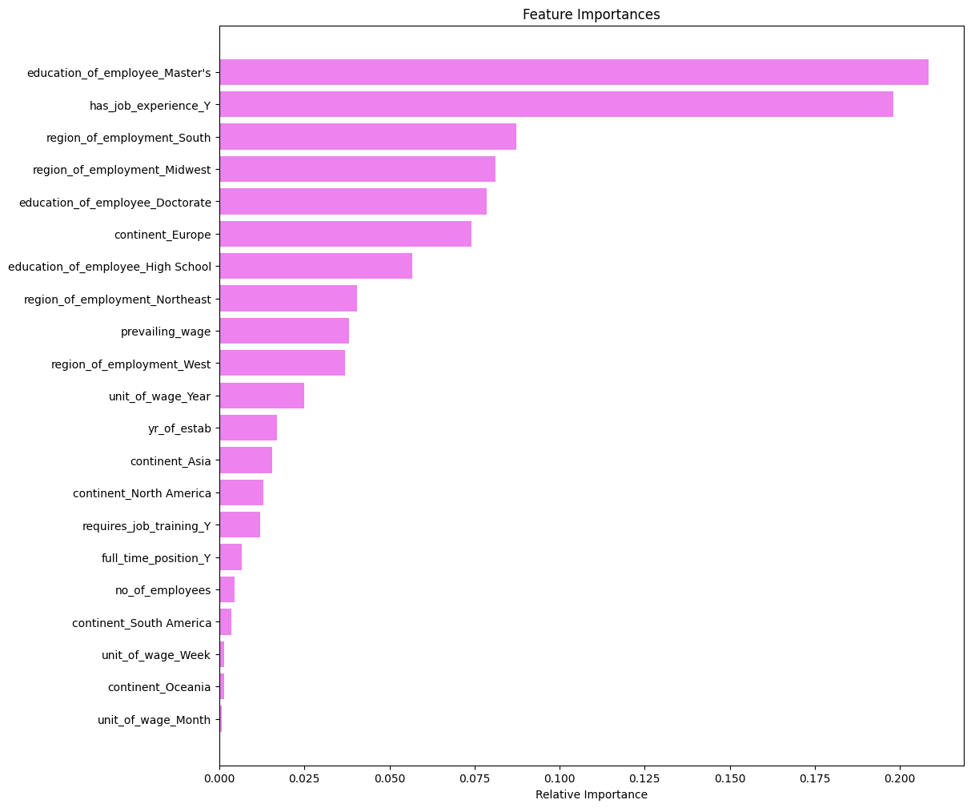
Summary of Feature Importance (Gradient Boosting Model)
Top predictors:
Master’s degree and prior job experience are the most influential factors in visa approval.
Employment region (especially South and Midwest) and Doctorate degree also significantly impact predictions.
Moderate factors:
Features like high school education, prevailing wage, and continent (Europe) contribute meaningfully but to a lesser extent.
Least influential:
Monthly wage unit, continent (Oceania/South America), and number of employees have minimal impact.
The model heavily favors education, experience, and job location as the strongest signals for certification outcomes.

Slide 50
Most Important Factors Used by the Gradient Boosting
Model for Prediction (1/2)
Based on the feature importance analysis from the tuned Gradient Boosting (GBM) model, the following variables contributed most significantly to predicting whether a visa application is Certified or Denied.
Feature Name | Importance Summary
prevailing_wage | Higher wages strongly correlate with certification. Certified cases cluster around high-salary roles.
education_of_employee | Higher education levels (Master’s/PhD) improve approval likelihood dramatically.
full_time_position_Y | Full-time jobs are far more likely to be approved than part-time equivalents.
has_job_experience_Y | Prior job experience boosts the chances of approval, indicating readiness and credibility.
requires_job_training_N | Applications that do not require job training tend to be more favorable.
unit_of_wage_Year | Yearly compensation is common among approved cases, reflecting stable, long-term roles.
continent_Asia / continent_Europe | Continent of origin contributes, with Europe showing the highest success rate, followed by Asia.

Slide 51
Most Important Factors Used by the Gradient Boosting
Model for Prediction (2/2)
📌 Insights
Economic factors (like wage and full-time status) carry the highest weight.
Human capital indicators (education and experience) are major differentiators.
Geography and role structure (unit of wage, training requirement) also influence decisions.
✅ Conclusion
The model heavily relies on features that reflect job quality, applicant qualifications, and stability of employment. These factors align closely with real-world visa approval criteria, adding interpretability and trust to the model’s predictions.

Slide 52
Actionable Insights & Recommendations (1/2)
📌 1. High-Skilled, Educated Applicants Drive Approval Rates
Applicants with a Master’s or Doctorate degree are far more likely to be certified.
Recommendation: Focus visa sponsorship resources on candidates with advanced degrees to maximize approval success.
📌 2. Prior Work Experience Strongly Boosts Certification Odds
Having relevant job experience is among the top predictors of success.
Recommendation: Clearly document and validate applicants’ prior work experience to strengthen the case file.
📌 3. Region of Employment Influences Approval Likelihood
Jobs located in the South and Midwest U.S. regions see higher certification rates.
Recommendation: Align recruitment and job placement strategies with regions historically showing favorable outcomes.

Slide 53
Actionable Insights & Recommendations (2/2)
📌 4. Prevailing Wage Matters—but Less Than Expected
While wage is important, human capital factors (education, experience) outweigh salary alone.
Recommendation: Maintain competitive wages but prioritize candidate qualifications when forecasting
📌 5. Categorical Details like Wage Unit and Continent Are Low Impact
Variables such as unit of wage or applicant continent (outside of Europe) have low predictive value.
Recommendation: Do not over-emphasize these factors in visa evaluation criteria
🚀 Actionable Strategy Moving Forward
Build an internal scoring system using the top predictive features (education, experience, location) to pre-screen candidates.
Automate risk assessment using the trained GBM model to prioritize low-risk, high-likelihood applications.
Use model insights to guide client education, helping businesses understand what makes an application stronger.

Slide 54
Final Conclusions (1/2)
1. Human Capital Drives Approvals
Education and experience are the strongest predictors of visa success.
Applicants with a Master’s or Doctorate and prior job experience see significantly higher approval rates.
Implication: Focus on qualified, experienced candidates to improve certification outcomes.
2. Job Structure Matters
Full-time, salaried roles have a much higher success rate than part-time or hourly roles.
Wage level plays a role but is secondary to candidate qualifications.
Implication: Structure roles as stable, full-time positions with competitive compensation.

Slide 55
Final Conclusions (2/2)
3. Geography Influences Outcomes
Southern and Midwestern U.S. regions show higher certification rates.
Applicants from Europe and Asia are more likely to be approved.
Very low wages are associated with increased denial rates.
Implication: Consider job location and applicant origin in application strategy, and avoid underpaying.
4. ML Adds Accuracy and Efficiency
Gradient Boosting (GBM) with SMOTE oversampling delivered the best balance across metrics.
It provided strong recall and interpretability through feature importance.
Addressing class imbalance was critical for model fairness and reliability.
Implication: ML enables scalable, data-driven decision support—especially when balanced and tuned appropriately.

Slide 56
Business Recommendations (1/2)
✅ 1. Implement Predictive Pre-Screening
Use the GBM model to automatically flag high-risk or low-likelihood cases, saving time for evaluators.
✅ 2. Focus on High-Probability Profiles
Prioritize applicants with:
Master’s or Doctorate degrees
Documented prior work experience
Full-time roles in high-certification regions (South, Midwest)
✅ 3. Educate Employers & Clients
Build guidelines explaining what factors improve approval odds, empowering employers to structure job offers accordingly.

Slide 57
Business Recommendations (2/2)
✅ 4. Create a Scoring Dashboard
Use model outputs to score and rank applications, allowing internal teams to allocate resources based on predicted outcome confidence.
✅ 5. Monitor Model Fairness
Periodically re-evaluate model behavior to ensure no unintentional bias toward specific continents, regions, or job types.

Slide 58
Suggestions for Additional Data to Improve Project
Outcome (1/3)
While the current dataset provided valuable features for predicting visa certification outcomes, incorporating additional variables could enhance both the accuracy and real-world utility of the model.
🧩 1. Job Title or Occupation Category
Why it helps: Different roles (e.g., Software Engineer vs. Retail Associate) have varying approval patterns.
Improvement: Enables the model to understand job-specific trends and identify high-approval job categories.
🧩 2. Employer Industry
Why it helps: Certain industries (e.g., tech, healthcare) are more favorable in visa processing.
Improvement: Adds context on the nature of the employer, helping the model differentiate between stable sectors vs. volatile ones.

Slide 59
Suggestions for Additional Data to Improve Project
Outcome (2/3)
🧩 3. Historical Approval Rate of Employer
Why it helps: Some employers may have a strong track record, while others may frequently receive denials.
Improvement: Adds a powerful behavioral signal that reflects the employer’s credibility and preparedness.
🧩 4. Job Offer Details (e.g., Contract Length, Benefits)
Why it helps: Offers that demonstrate long-term commitment and stability are more likely to be approved.
Improvement: Helps model capture the strength of the offer beyond wage and full-time status.
🧩 5. Applicant Age or Years of Experience
Why it helps: Adds context to job experience; a young applicant with 2 years' experience is different from a mid-career professional.
Improvement: Enables finer segmentation of candidate profiles and more personalized prediction.

Slide 60
Suggestions for Additional Data to Improve Project
Outcome (3/3)
🧩 6. Application Type (e.g., New vs. Extension)
Why it helps: Extensions or renewals may have different approval dynamics than first-time applications.
Improvement: Distinguishes between lower-risk repeat approvals and new, untested cases.
🧩 7. Processing Time or Service Center Data
Why it helps: Some service centers may have higher or lower approval rates and different criteria emphasis.
Improvement: Adds geographic and procedural nuance that could increase prediction accuracy.
🔍 How It Could Improve the Project
Boosts Model Accuracy: Adds more real-world variables the model can learn from.
Enhances Interpretability: Helps explain predictions in more detail (e.g., "this role has a higher rejection rate").
Supports Risk Scoring: Enables risk-based triage of applications based on deeper patterns.

Slide 61


